Slide 1
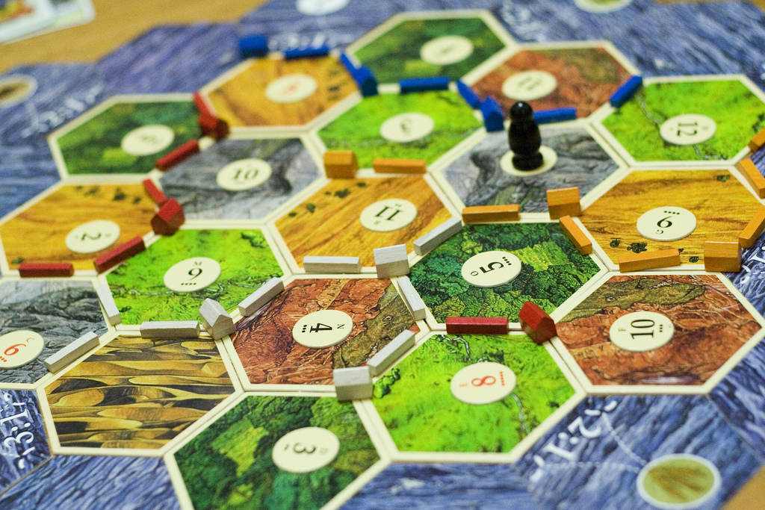
Modeling Settlers of Catan with Degrees of Freedom
Michael L Perry
Michael@qedcode.com

Slide 2


Slide 3


Slide 5
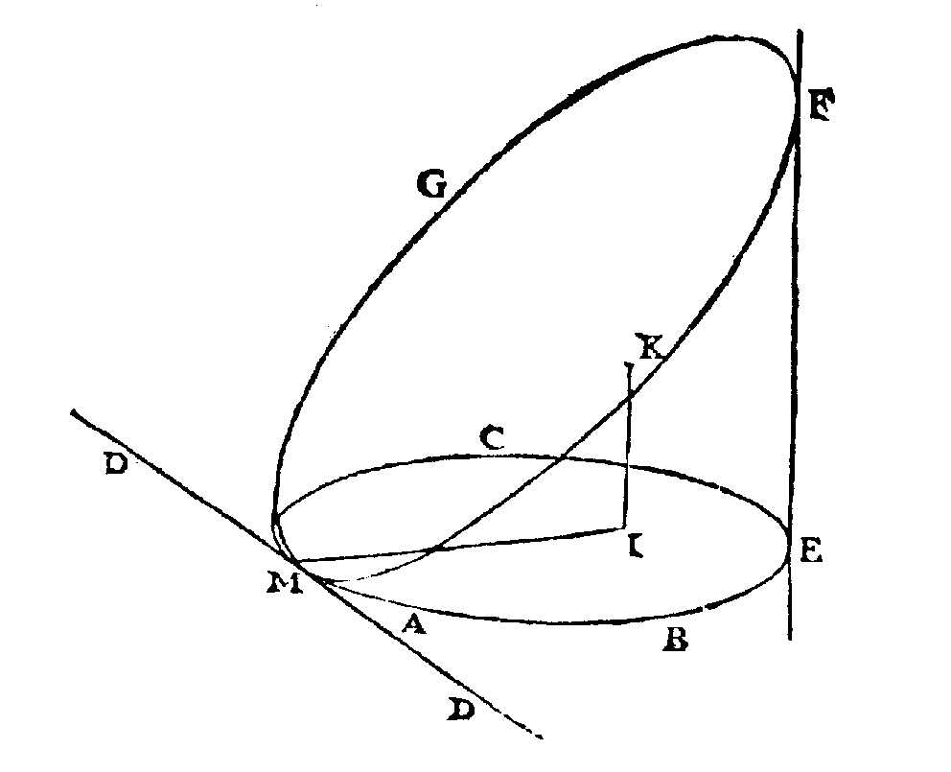

Slide 6
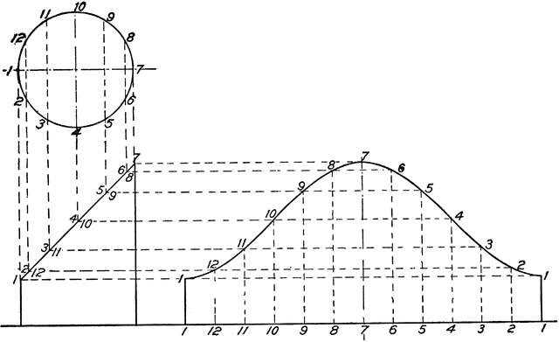


$$x^{2}+y^{2}=1$$
$$x=z$$

Slide 7



Degrees of Freedom
Number of unknowns
minus
number of equations
$$x^{2}+y^{2}=1$$
$$x, y, z$$
$$x=z$$

Slide 8






$$x^{2}+y^{2}=1$$
$$x=z$$
$$t$$
Independent
$$x=sin⁡(t)$$
$$y=cos⁡(t)$$
Dependent
$$z=sin⁡(t)$$

Slide 9
What is Independent?
public class MyClass
{
private string _thisIsIndependent;
}
public class MyClass
{
private string ThisIsToo { get; set; }
}
public class MyClass
{
// This is not.
private readonly Thing _thing;
public MyClass(Thing thing)
{
_thing = thing;
}
}

Slide 10
What is Dependent?
public class MyClass
{
private readonly Thing _thing;
public Thing(Thing thing)
{
_thing = thing;
}
// This is dependent.
public string Property
{
get { return _thing.Property; }
set { _thing.Property = value; }
}
}

Slide 11
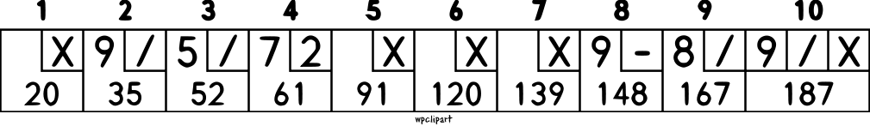

Slide 12


Slide 13
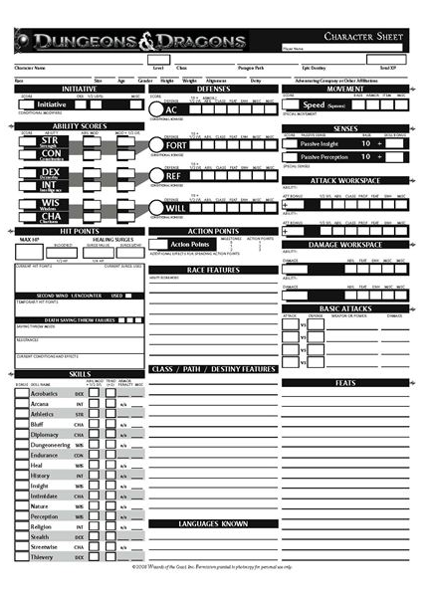

Slide 14
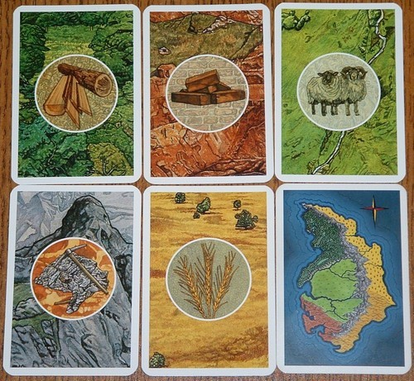
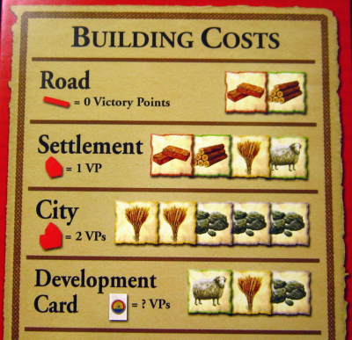

Slide 15
Degrees of Freedom
Add features without breaking existing code
Avoid the domino effect
Understand context
Preserve history

Slide 16
qedcode.com
Michael L Perry
github.com/MichaelLPerry/dof

